Slide 1
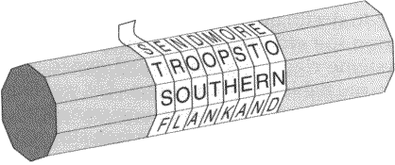
Transposition Ciphers
By: Pavleen Kaur

Slide 2
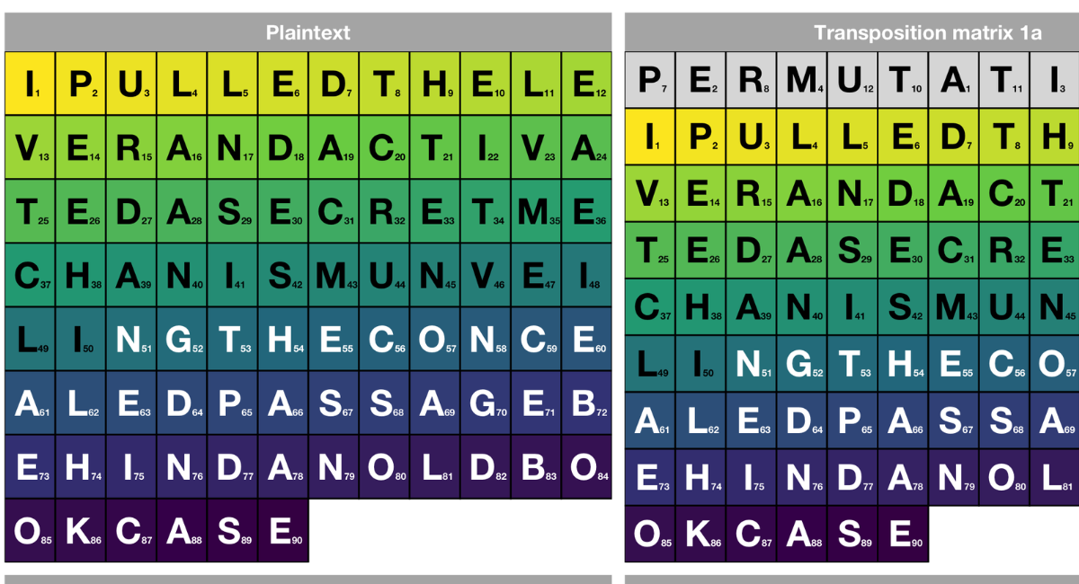
What are Transposition Ciphers
Transposition ciphers are a essential aspect of cryptography
This is a way of hiding data by shifting their position
This creates a new word, the ciphertext

Slide 3

Why were Ciphers used
Ciphers originally began being used during the Middle Ages continuing through WWll
They were often used in military and political practices to keep communications private and secured

Slide 4
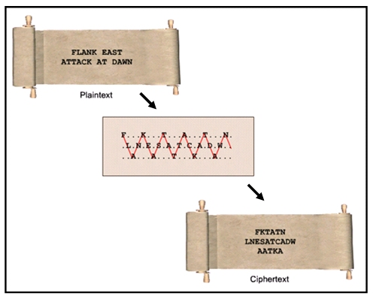
What was the purpose of these Ciphers
During wartime they would encrypt messages to send them to one another
This would avoid the opposing side from receiving information about strategies they had to attack

Slide 5
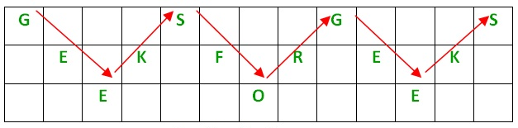
Rail Fence Transposition Cipher
This is one of the simplest ciphering methods
You write the text in diagonal format which encrypts it
To read it properly, you must follow the words in a zigzag pattern

Slide 6
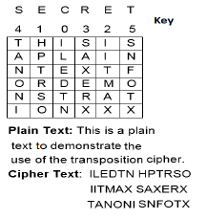
Block (Single Columnar) Transposition Cipher
For this ciphering method you write the text out into rows and columns
Then you read the text column by column which creates the encryption
A keyword is given for the number of rows to help decrypt the message

Slide 7
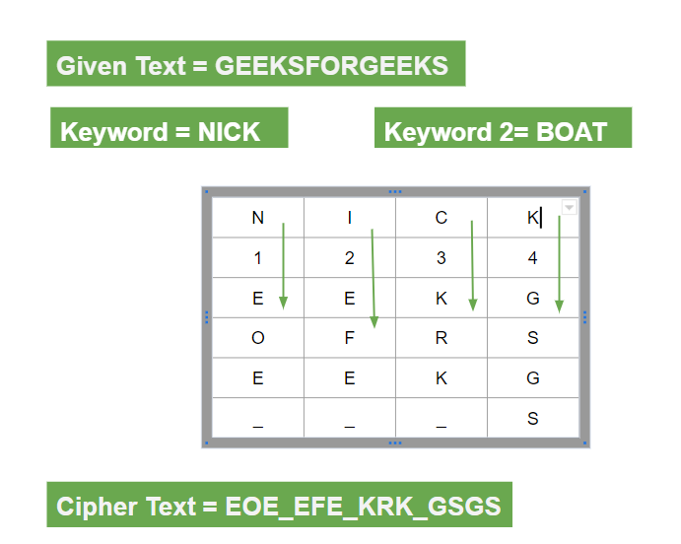
Double Columnar Transposition Cipher
The point of this ciphering method is to encrypt the message twice
This follows the same procedure as Block ciphering but you use the first keyword to decrypt the message again to reveal the message

Slide 8
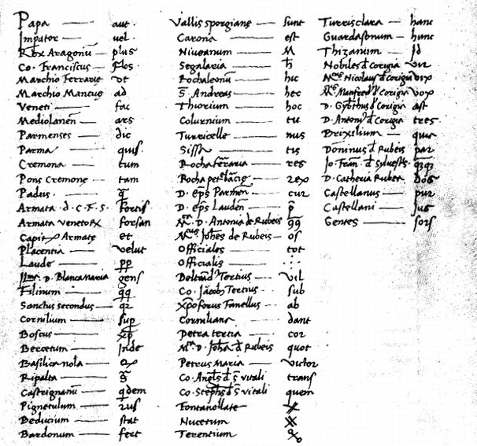
Downsides of Ciphers
People would often decrypt message as a form of attacking
There was also a high risk of errors in the messages since it was tedious to encrypt the messages correctly

Slide 9
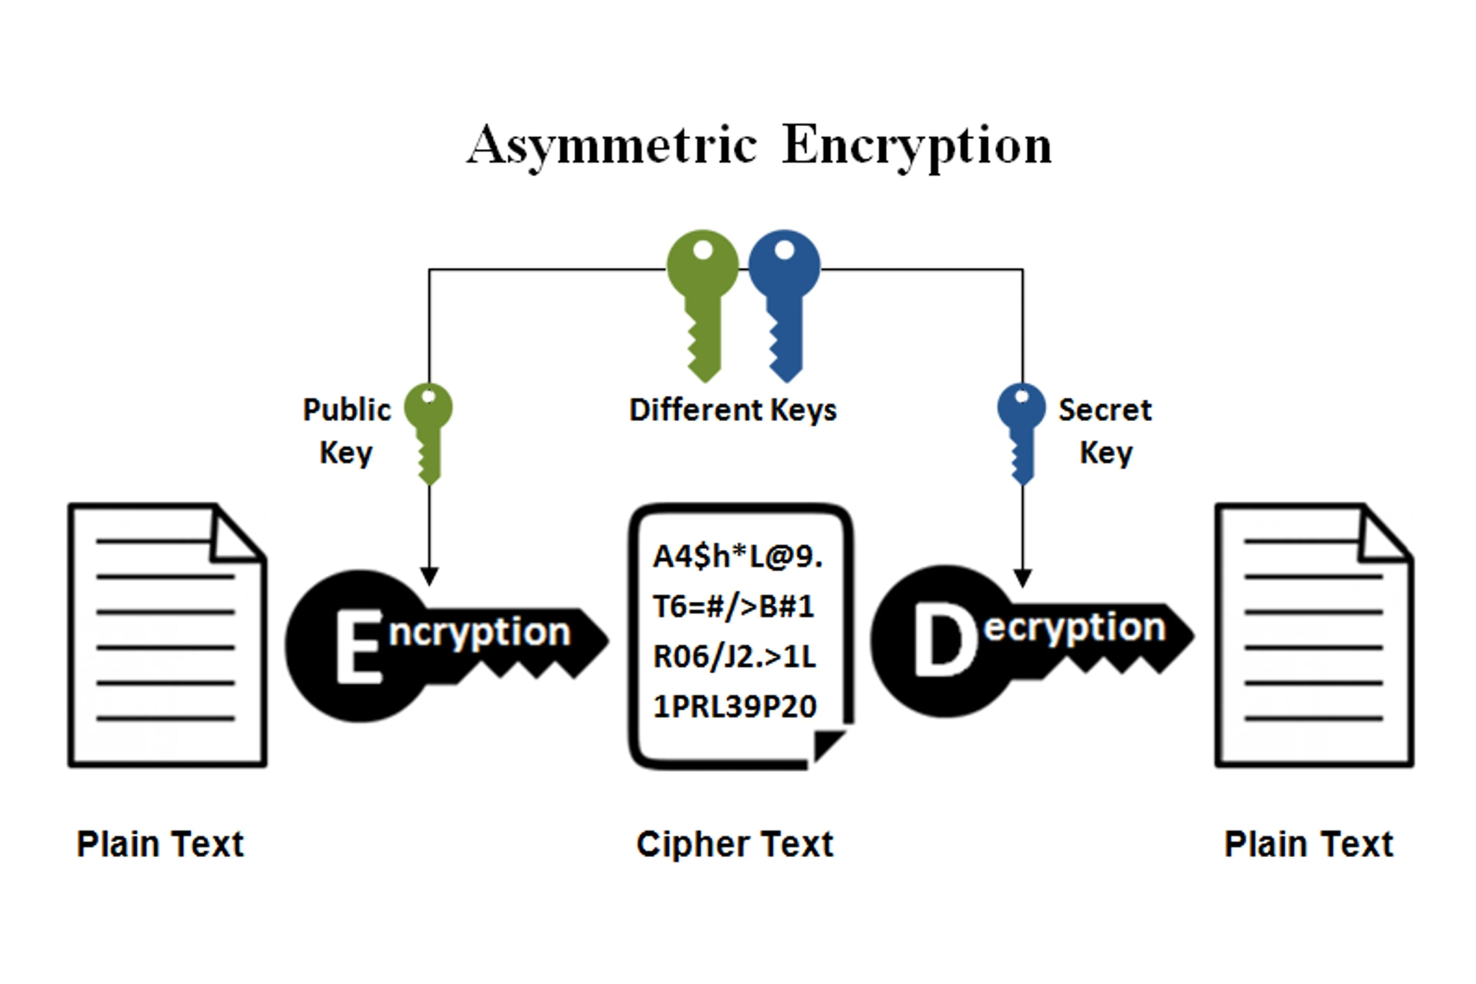
Modern Day Cryptography
Ciphers are used to rearrange unknown data, and help make it easier to understand in complex algorithms
This creates a base for encryption allowing for several methods to be used for extra security

Slide 10
Citations
“Transposition Cipher Techniques in Cryptography.” GeeksforGeeks, 23 July 2025, https://www.geeksforgeeks.org/computer-networks/transposition-cipher-techniques-in-cryptography/.
“The History of Cryptography.” IBM, https://www.ibm.com/think/topics/cryptography-history.
“Cryptography - Columnar Transposition.” Tutorials Point, https://www.tutorialspoint.com/cryptography/cryptography_columnar_transposition.htm.

